Slide 1


Big Data
Industry Use Case for AMZ Bank
Hariprabhaa Murugesan

Slide 2



Problem Highlights
Customer Churn Rate 20%
Credit Sales Revenue 15%
Fraudulent Activities

Slide 3
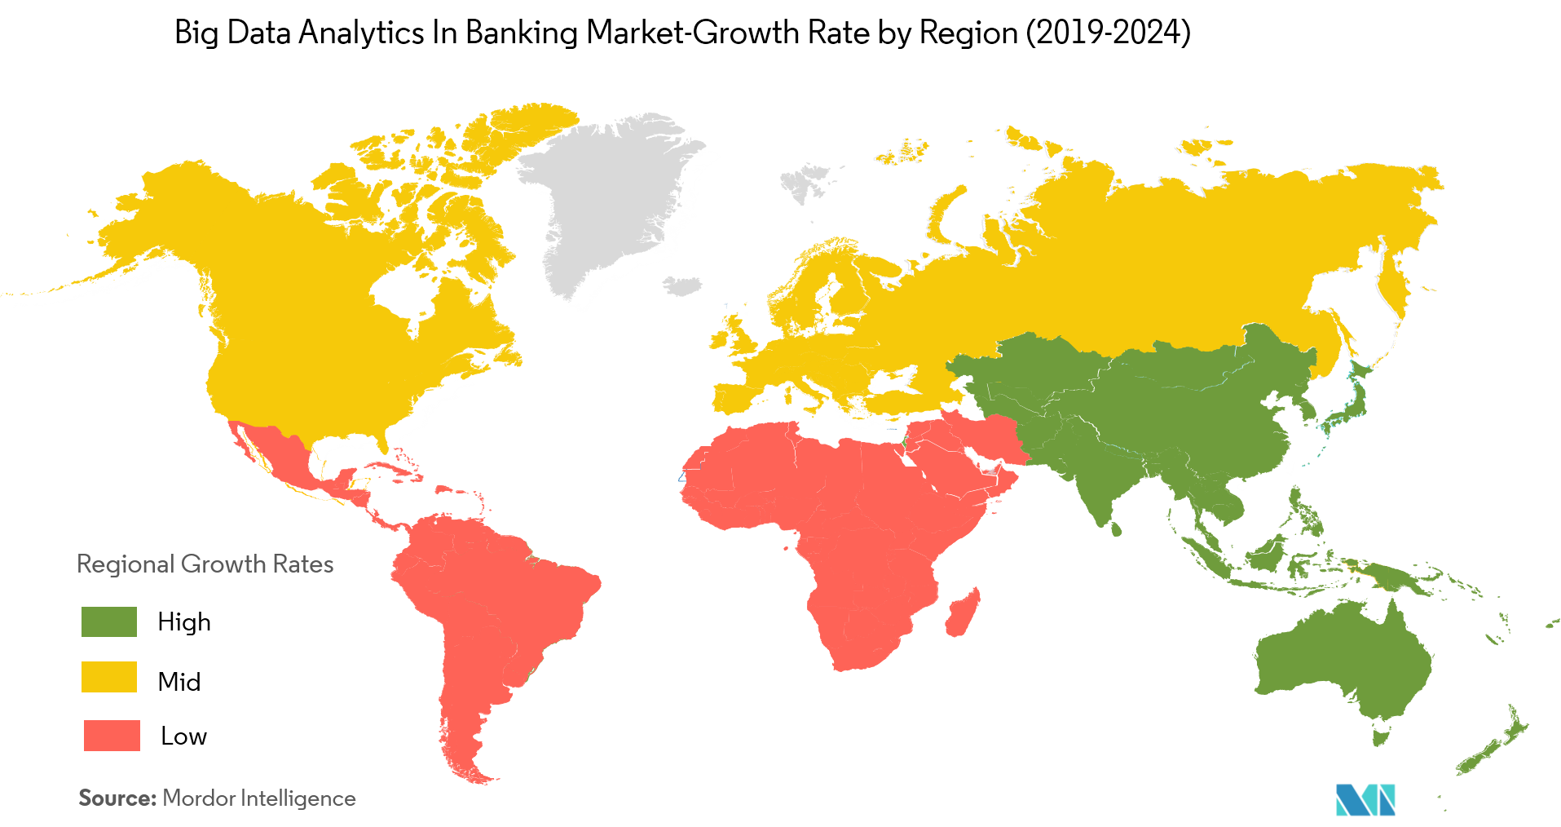
Key Trends
According to BFSI Industry Experts, the amount of banking data generated each second will grow 700% by 2020.
Chatbots are expected to handle no less than 85 percent of customer service interactions by next year.

Slide 4
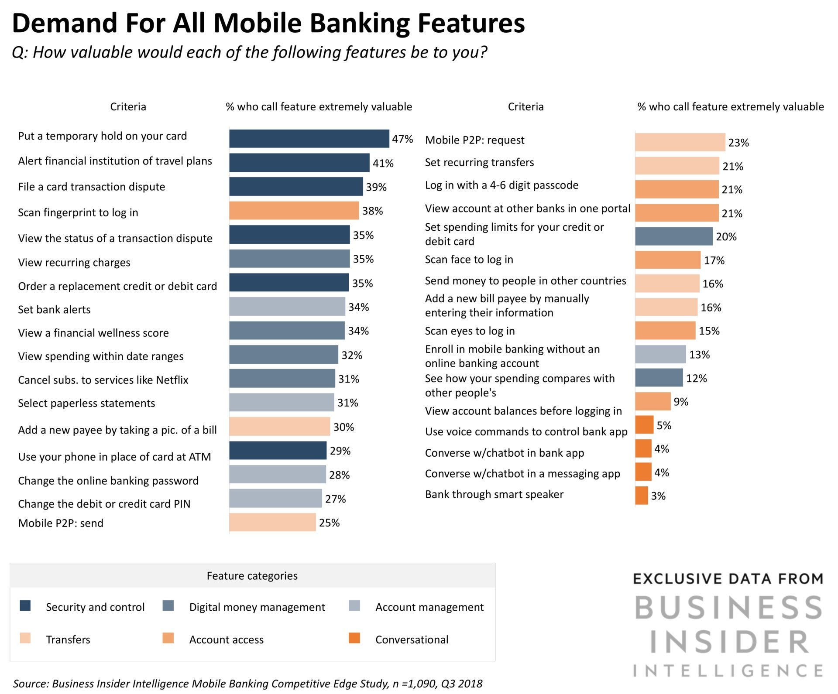
Key Trends Continued…

Slide 5

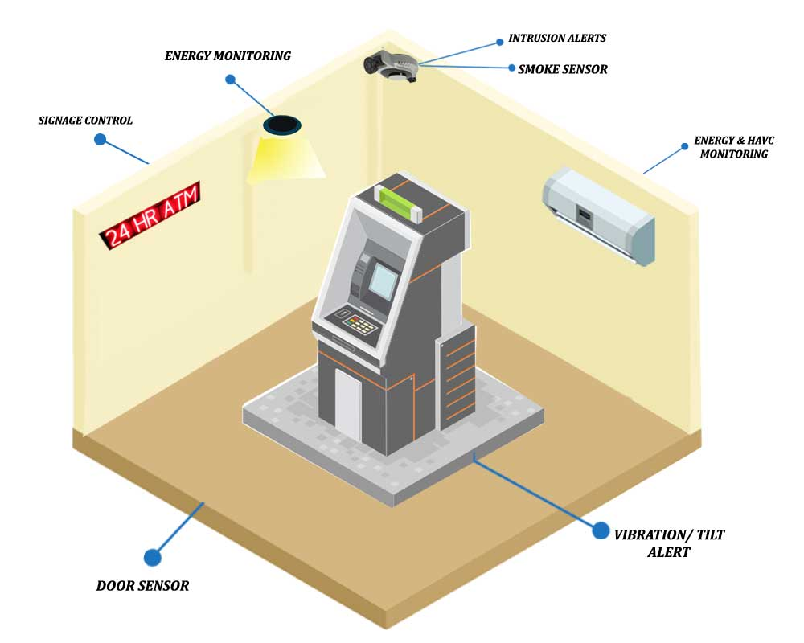
Proposed Solution
Robo-advisors act in the form of chatbots
  Handling monotonous tasks
  Walking through the sales cycle
  Offering suggestions & advice
Sensors
  Anything from ATMs to information kiosks could be equipped with sensing technology to monitor and take action on the consumer behalf.
Targeted marketing strategies.

Slide 6
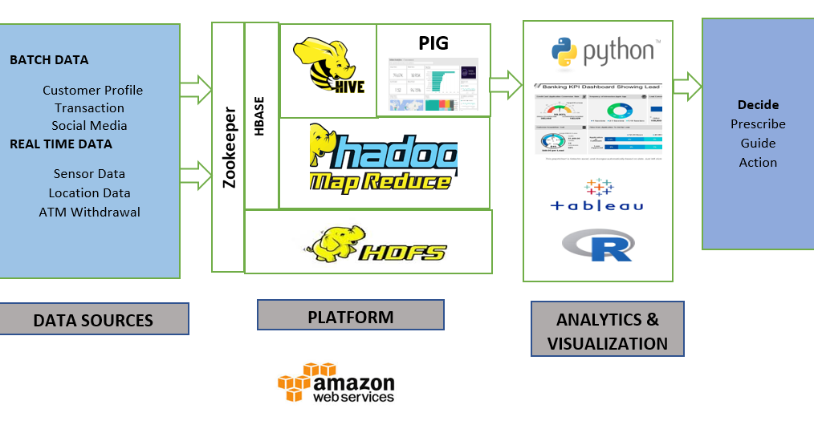


Proposed Solution Architecture
0

Slide 7
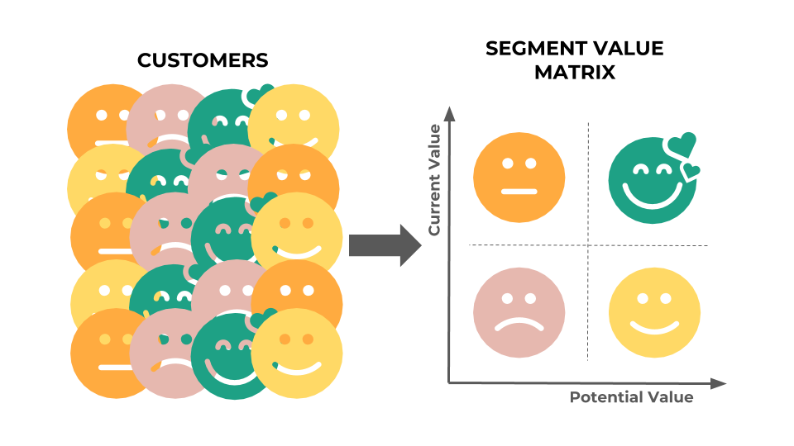
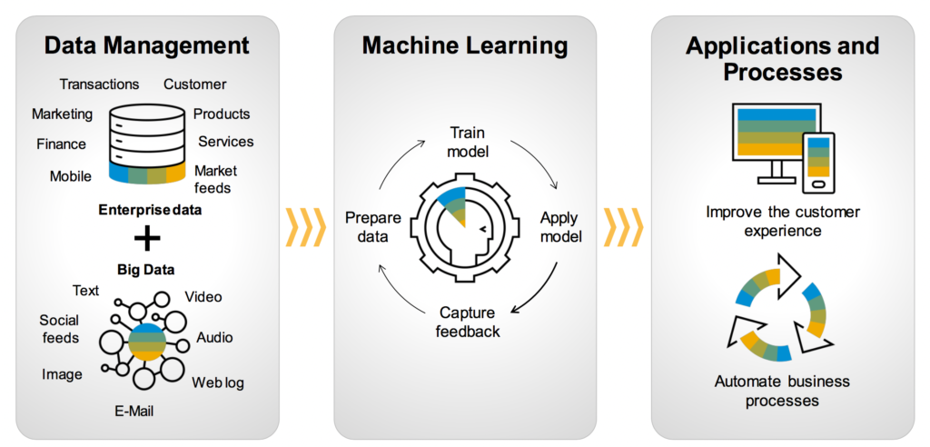

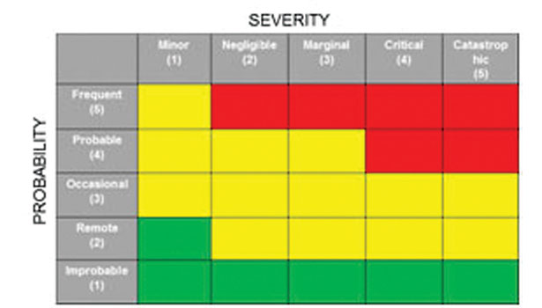
Implementation Techniques
Customer Segmentation -> Segmentation Analysis
Customer Feedback Analysis -> Sentiment analysis by Natural Language Processing algorithms
Robotic Process Automation with Artificial Intelligence
Risk Matrix Chart -> Plots the severity of an event and the probability of it to occur

Slide 8
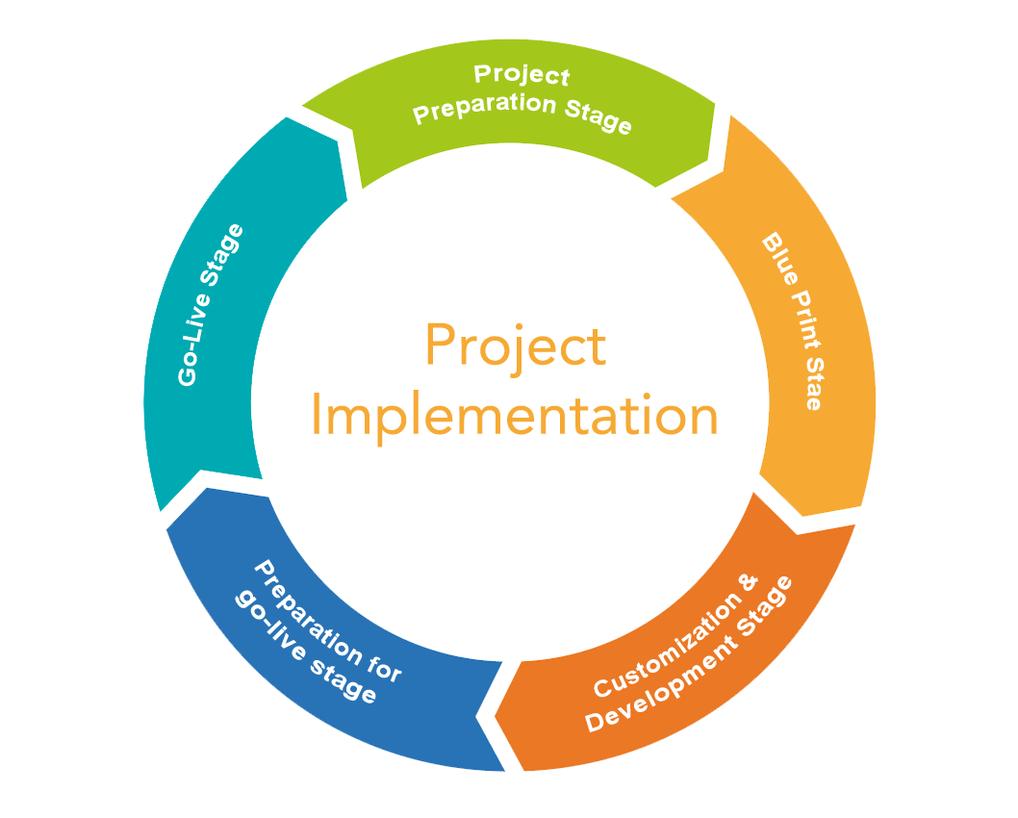
Deployment Strategy
Determine the most important business objectives.
Establish a cross-functional business domain team.
Choose the Service Provider – AWS, GCP & Azure.
Compile a list of structured and unstructured data sources.
Create big data architecture to support the objective.

Slide 9
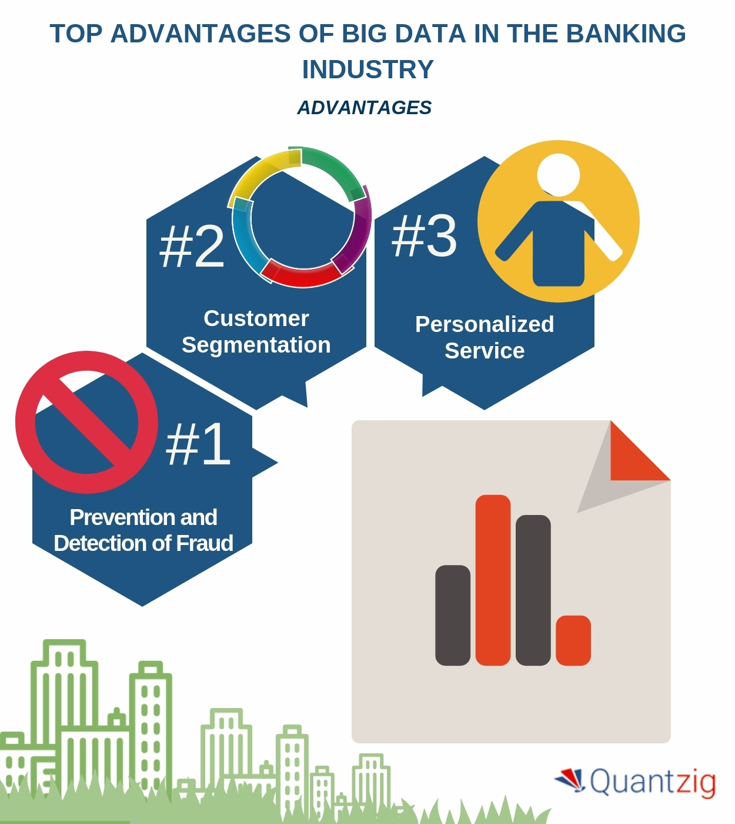
Benefits
Provides Personalized Banking Solutions to Customers
Gain a Complete View of Customers with Profiling.
Identify Opportunities for Upselling and Cross-selling
Improvement of customer service
Fraud management & prevention
Efficient Risk Management
Significant Cost Savings

Slide 10

Summary
0
Successfully acquire, engage and retain customers.
Great chance to increase the market share and take it to the next level.
Thank You!

